Slide 1


Elementary Science
Science Focus Lesson
SC.5.E.7.3
Weather
Polk County Public Schools
Notes:
Benchmark Clarifications
Students will identify and/or describe how air temperature, barometric pressure, humidity, wind speed and direction, and precipitation describe weather in a particular place and time.
Students will identify or distinguish the forms of precipitation (rain, snow, sleet, and hail) and their related weather conditions.
Students will distinguish weather conditions among different environments.
Students will describe the temperature and precipitation of different climate zones as they relate to latitude, elevation, and/or proximity to bodies of water.
Content Limit
Items assessing weather and climate are limited to conceptual understanding.
Items will not assess the difference between climate and weather.
Items will not address or assess the interpretation of specific characteristics used to forecast weather.
Items addressing the types of clouds are limited to cumulus, cirrus, stratus, and cumulonimbus as they relate to weather but will not require differentiation among these types of clouds.
Items assessing climate zones are limited to polar, tropical, and temperate.
Items assessing weather-related differences among different environments may include desert, grassland, rainforest, tundra, and wetland.
Items will not require knowledge of specific geographic locations.
Items will not assess fronts.
Items may refer to common tools used to measure air temperature, barometric pressure, humidity, wind speed and direction, and precipitation but will not assess specific knowledge of the tools.
Stimulus Attribute
Scenarios may include a weather map with a key explaining weather symbols.
Dual thermometers showing degrees Fahrenheit and degrees Celsius must be used if the scenario requires an illustration of a thermometer.
Wind speeds will be shown in miles per hour (mph).
The phrase air pressure should be used rather than the phrase barometric pressure.

Slide 2
SC.5.E.7.3
Benchmark: Recognize how air temperature, barometric pressure, humidity, wind speed and direction, and precipitation determine the weather in a particular place and time.
Essential Question:
How does temperature, air pressure, humidity, wind speed and direction, and precipitation determine the weather in a particular place and time?
Vocabulary:
temperature humidity
air pressure wind speed
hail sleet

Slide 3
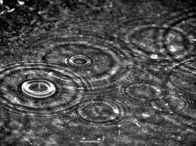
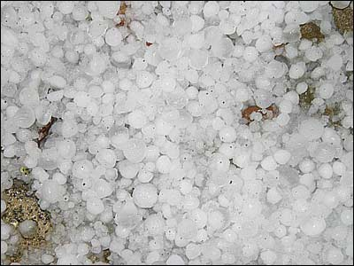
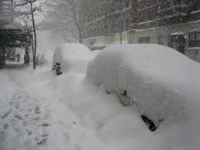
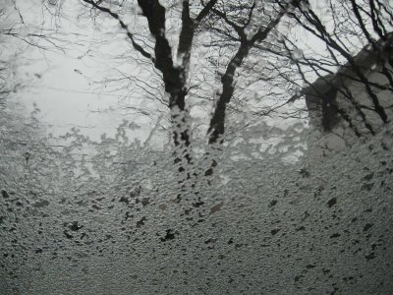
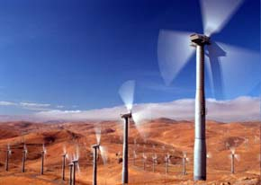
What is Weather?
Weather is the condition of the atmosphere at a place for a short period of time.

Slide 4
How is weather described?
Weather is described by using
air temperature
air pressure (barometric pressure)
humidity
wind speed and direction
precipitation

Slide 5
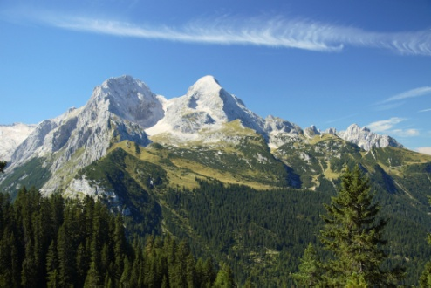
Air Temperature
Air Temperature is how hot or cold the air is.
A thermometer measures the temperature of the air in degrees Celsius or Fahrenheit.
                The higher the temperature the warmer the weather.
The lower the temperature the colder the weather.
The temperature falls as the altitude rises.
The temperature of land near a large body of water is often moderate because it usually takes longer for the water to cool or heat which keeps the land next to it cooler or warmer.

Slide 6
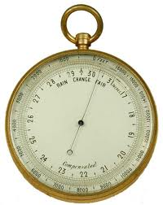
Air Pressure
Air Pressure is also called Barometric Pressure.
Air pressure is the weight of air pressing on everything around it.
Air pressure is measured by using a barometer.
Notes:
Air presses on objects from all sides, not just down on them.
Thinner means that the air molecules are more spread out. Air is thinner at higher altitudes than air at low altitudes. We feel this when you travel to a mountain and try to hike. It is harder to breath, catch your breath, when you are use to sea level.

Slide 7
Conditions affecting Air Pressure
Three conditions affect air pressure
  Water Vapor makes air moist. Moister air has a lower air pressure- drier air has higher air pressure
  Temperature – when air gets warmer the pressure goes down and when it gets cooler the pressure goes up.
  Altitude – Air at pressure goes down at higher altitudes because the air is thinner.
  When the air pressure changes you can tell the weather will change. Rising air pressure means clearer weather is coming. Falling air pressure means unsettled or wet weather is coming.

Slide 8
Summarizing
Partner A to B: Define weather and terms used to describe weather conditions
Partner B to A: What happens to the weather when the temperature rises?
Partner A to B: Describe air pressure.
Partner B to A: What weather condition is predicted when air pressure rises?
Notes:
Give students 30 seconds of think time before sharing their answers with their shoulder partner.
Question 1 Weather is the condition of the atmosphere at a place for a short period of time. It is described by air temperature, air pressure (barometric pressure), humidity, wind speed and direction, and precipitation.
Question 2 When the temperature rises the weather is becoming warmer.
Question 3 – Air pressure is the weight of air pressing on everything around it.
Question 4 – When the pressure rises the weather is becoming clearer.

Slide 9

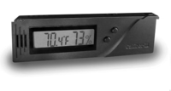
Humidity
Water vapor in the air is called humidity.
On very humid days the air is holding a lot of water vapor and your skin may feel damp.
Relative humidity is the amount of water vapor that the air is holding compared with the amount that it could hold at that temperature.
Relative humidity is measured with a hygrometer.
Fun Fact!
Some hygrometers use hair to determine the humidity because hair on your head and in the hygrometer shrinks and lengthens based on how much water vapor is in the air
Notes:
Relative humidity of 100% means that the air is holding all of the water vapor it can hold at that temperature.
Hair hygrometers – a hair is attached to a pointer. When humidity goes down, the hair shrinks and the pointer moves down. When humidity goes up, the hair lengthens and the pointer moves up. The numbers on the Hygrometer show the humidity measurements.

Slide 10

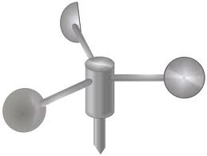
Wind Speed and Direction
Wind is moving air. Air moves because the surface of the Earth is not heated evenly.
Wind speed is measured with an anemometer.
Wind direction is measured by a wind vane.
Land near a large body of water often has a sea breeze or a land breeze.
Anemometer
Wind Vane

Slide 11
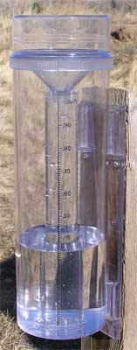
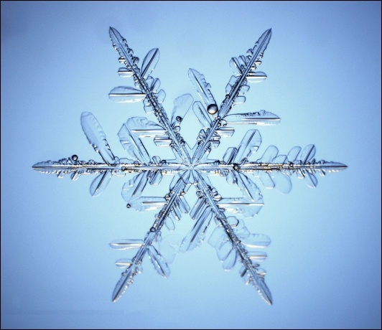
Precipitation
Water that falls to Earth’s surface is called precipitation.
Sleet-small pellets of ice
Sleet falls at below freezing temperatures.
Snow – ice in the form of six sided crystals - Measured with a snow gauge
Snow may fall when temperature reaches freezing.
Rain – Liquid drops
Measured with a rain gauge
Rain falls at above freezing temperatures.
Hail- chunks or balls of ice
Hail can fall at above freezing temperatures.

Slide 12
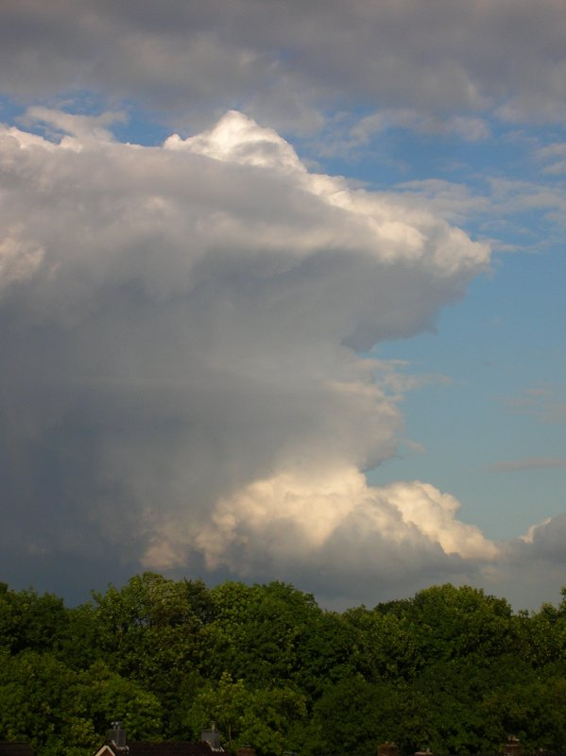
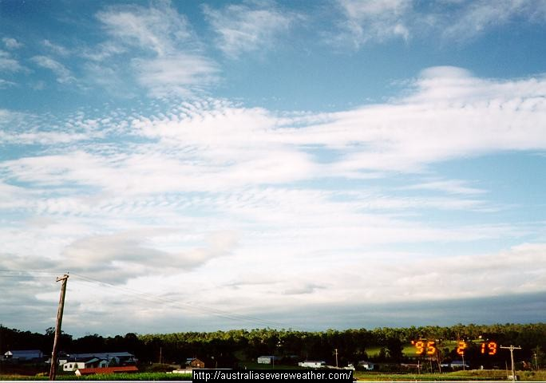

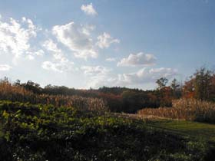
Clouds
Each kind of cloud tends to go with a different kind of weather
Cirrus clouds may be followed by rain or snow in a few hours.
Stratus clouds can bring light rain.
Cumulonimbus clouds produce thunderstorms- they are also called thunderheads
Clouds prevent direct sunlight from reaching Earth so on cloudy days the temperature does not raise much!
Cumulus clouds are “fair-weather” clouds

Slide 13
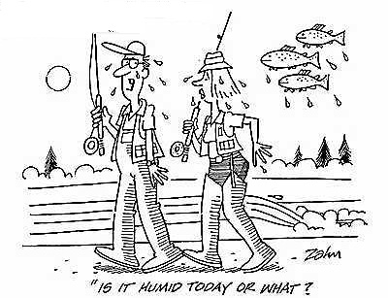
Summarizing
Talk with your partner to answer the following question
What characteristic of weather would explain why your skin feels damp during the summer months in Florida?
Notes:
In the summer time the air holds a lot of water vapor which means that it is very humid.

Slide 14
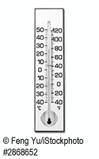
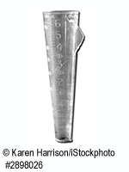
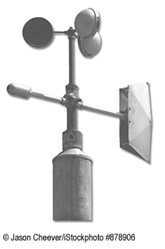
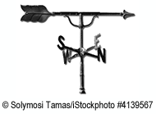
Guided Instruction:
Which tool is used to measure how much rain falls during a storm?
A. B.
C. D.

Slide 15
B
The answer is
A rain gauge is used to measure the amount of rain fall.
Notes:
Happiness cannot be measured

Slide 16
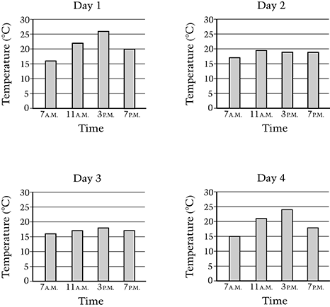
Guided Instruction:
Grace's class measured the temperature outside four times a day for four days in a row. Their results are shown below.
Which two days were most likely cloudy based on the results?
Day1 & Day 2
Day 2 & Day 3
Day 3 & Day 4
Day 4 & Day 1

Slide 17
B
The answer is
  The two days are Day 2 and 3 because the temperature does not increase much during the day.
  When clouds are present there is less direct sun light which does not allow for much heating of the air.

Slide 18
Guided Instruction
Jenny measures the outside temperature as 16 degrees Celsius, 61 degrees Fahrenheit. She observes precipitation falling from the clouds in a solid form. What type of precipitation is Jenny most likely observing?
    A. hail
    B. rain
    C. sleet
    D. snow

Slide 19
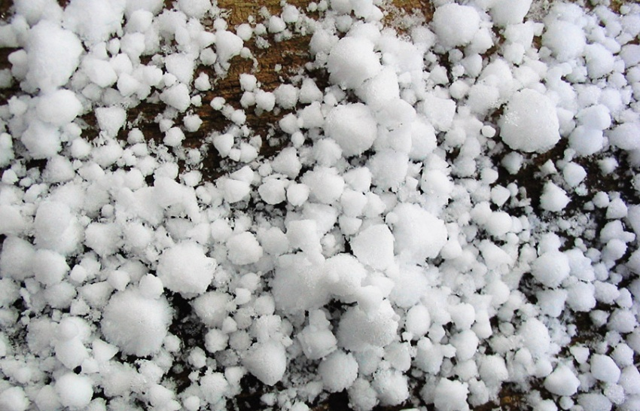
A
The answer is
Hail is solid precipitation that forms high in the atmosphere where the temperature is below freezing even though the surface temperature is above freezing.
Notes:
Rain is a liquid form of precipitation.
Sleet is a solid form of precipitation, it occurs when the air temperature at the surface is below freezing.
Snow is a solid form of precipitation, it occurs when the air temperature is near or below freezing.

Slide 20
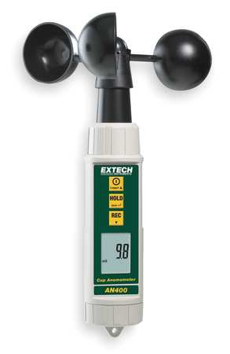
Guided Instruction:
Which tool is used to measure the winds speed?
A. B.
C. D.

Slide 21
D
The answer is
Anemometer is used to measure the speed of the wind.

Slide 22
Summarizing
Essential Question:
How can clouds help us to make predictions about changes in the weather?
Notes:
Different types of clouds indicate different weather patterns. Cumulonimbus clouds produce thunderstorms. Cirrus clouds may be followed by rain or snow. Cumulus clouds are “fair-weather” clouds. Stratus clouds can bring light rain.

Slide 23
Check Your Understanding
1. Which tool is used to measure wind direction?
A. B.
C. D.

Slide 24
Check Your Understanding
2. Alexis measures the outside temperature as 16 degrees Celsius, 61 degrees Fahrenheit. She observes precipitation falling from the clouds in a liquid form. What type of precipitation is Jenny most likely observing?
    A. hail
    B. rain
    C. sleet
    D. snow

Slide 25
Check Your Understanding
3. Grace's class measured the temperature outside four times a day for four days in a row. Their results are shown below.
Which two days were most likely sunny based on the results?
Day1 & Day 2
Day 2 & Day 3
Day 3 & Day 4
Day 4 & Day 1

Slide 26
Check Your Understanding
4. Philip measured the temperature on the top of the Grand Teton mountains in Wyoming and the temperature at the lowest point in the valley below. Which of the following descriptions would best describe the temperatures that Philip measured?
The temperature on the top of the mountain much higher than the temperature in the valley.
The temperature on the top of the mountain was cooler than the temperature in the valley.
The temperature on the top of the mountain was a little higher than the temperature in the valley.
The temperature on the top of the mountain was the same as the temperature in the valley.

Slide 27
Check Your Answers
C. Wind Vane
B. Rain
D. Day 4 and Day 1
B. The temperature on the top of the mountain was cooler than the temperature in the valley.
Notes:
Wind Vanes measure wind direction
Rain is the only liquid form of precipitation listed and it can fall at above freezing temperatures.
Day 4 and Day 1 are the best choices because the temperature heats up in the middle of the day and then cools back off as the sun becomes less direct.
Temperatures are cooler at higher elevations

Slide 28
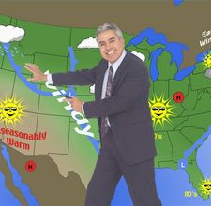
Summary Question
With your shoulder partner, list the characteristics of weather that are reported on by a meteorologist.
Notes:
air temperature, barometric pressure, humidity, wind speed and direction, and precipitation

